Slide 1

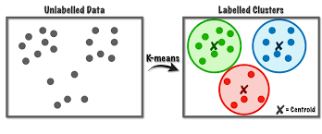
European soccer leagues and AI
Andrew Sautel

Slide 2
The problem
Lot of debate on the quality of leagues
Quality of leagues is often a push and pull factor to clubs for players
Quality of leagues is slander for fans

Slide 3

The purpose
Determine the quality of the first division leagues of most of the UEFA(Union of European Football Associations) member nations

Slide 4
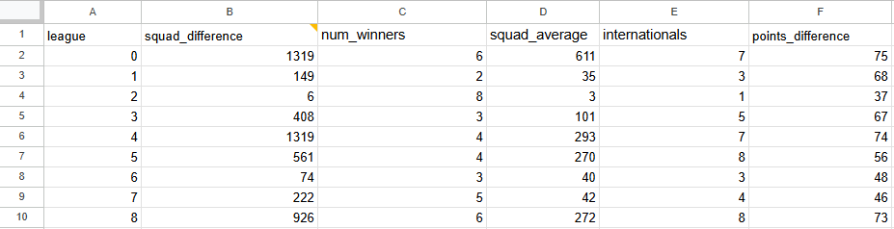
Data
Squad values: estimated value of the players on the team
League: mark what league it is
squad_difference: difference in squad value between the winner and last place team in the league in 23/24 season (in millions)
num_winners: number of different winners since 2003/2004 season
squad_average: average squad value in the league (in millions)
internationals: number of teams competing internationally
points_difference: point difference between winner and last place in 23/24 season

Slide 5


Data collection
Data on squad values was taken from transfermarkt.us (widely recognized website for market values)
Rest of the data was found on FotMob (app for tracking soccer)

Slide 6
Unsupervised learning: k-means clustering
Organize data into groups by similarity
ie: how similar the leagues are to each other
Assign centroids for the data randomly (or not)
Assign points to a centroid
Done by calculating euclidean distances
In a loop, update the centroid
Find the average value of the points in each cluster
The new centroid is this average value
Assign points to a centroid
Do these steps until the centroid doesn’t change position

Slide 7

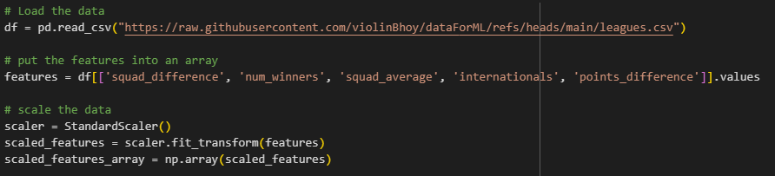
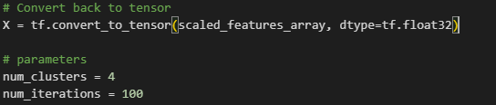
Setup for algorithm
Dictionary to tie the league number to the league
Load data
Make feature array
Scale the data
Convert data into something tensor can use
Set number of clusters and number of iterations (initially 100)

Slide 8
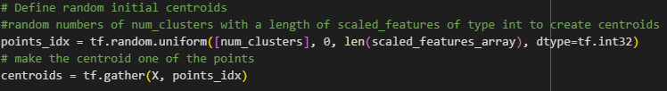
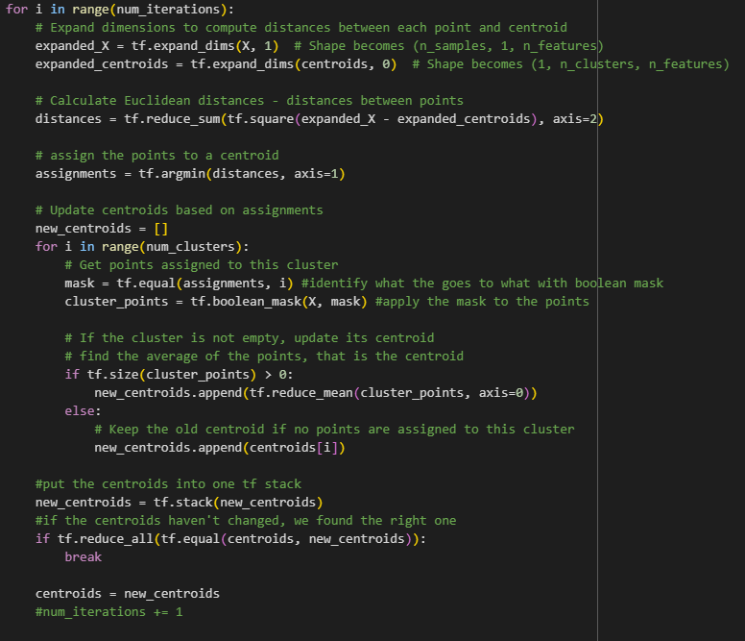
K-means algorithm
Define initial centroids
Set up a for loop
Change the shape of array to deal with euclidean distances
Calculate euclidean distance
Assign points to a centroid
Does so by finding the smallest distance between the point and a cluster
Another for loop for each cluster
Get points for each centroid
Update the centroid if the cluster is not empty
Get the centroid from the average value of all of the points in the cluster
Add centroids to a stack
If the centroids didn’t change, then stop running the algorithm

Slide 9
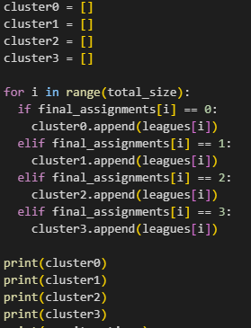
Dealing with the model
Put the result into final_assignments
Make arrays to easily view clusters

Slide 10
Results
Even though the results varied a lot, here’s one result:
['england', 'spain', 'italy', 'germany', 'france']
['republic of ireland', 'poland', 'albania', 'north macedonia', 'romania', 'norway', 'sweden', 'finland', 'kazakhstan', 'georgia']
['switzerland', 'austria', 'hungary', 'slovenia', 'bosnia', 'montenegro', 'moldova', 'ukraine', 'belarus', 'lithuania', 'belgium', 'denmark', 'azerbaijan', 'cyprus', 'iceland', 'armenia']
['scotland', 'portugal', 'czech republic', 'slovakia', 'croatia', 'greece', 'serbia', 'bulgaria', 'turkey', 'latvia', 'estonia', 'netherlands', 'israel', 'wales', 'northern ireland', 'luxembourg']

Slide 11
Edits
Replaced the for loop with a “while True” loop instead of iterating through num_iterations, came up with a result in less than 10 iterations
Set the centroid to be at a specific point
The points were specified by the ranks (next slide)

Slide 12
Doing ranks
Germany
Portugal
Switzerland
Kazakhstan

Slide 13
Results from adding in the ranks
These were the clusters that always came up
['england', 'spain', 'italy', 'germany', 'france']
['scotland', 'portugal', 'czech republic', 'croatia', 'serbia', 'turkey', 'netherlands', 'wales']
['switzerland', 'austria', 'slovakia', 'hungary', 'bosnia', 'greece', 'bulgaria', 'moldova', 'ukraine', 'belarus', 'lithuania', 'latvia', 'estonia', 'belgium', 'denmark', 'israel', 'azerbaijan', 'cyprus', 'iceland', 'armenia', 'northern ireland', 'luxembourg']
['republic of ireland', 'poland', 'slovenia', 'montenegro', 'albania', 'north macedonia', 'romania', 'norway', 'sweden', 'finland', 'kazakhstan', 'georgia']

Slide 14
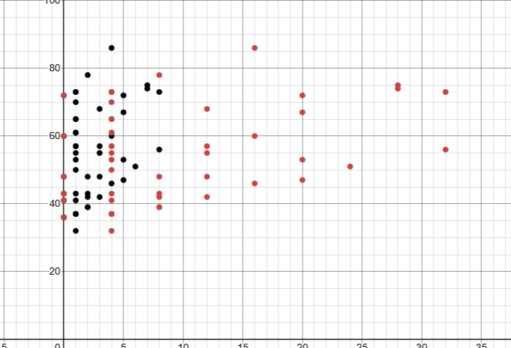
More edits
Edit the scaling to give weights to a certain feature
So here’s the hypothesis: if I multiply by x and x > 1 the values get farther away
This makes the algorithm prioritize the similarities and differences of that feature more than others
If x < 1, it would make the feature less important
But since euclidean distances are based on squared values, multiplying by 2 would actually change the data by a factor of 4

Slide 15
Basing on competitiveness
Prioritize num_winners and points_difference
Deprioritize average squad value
['italy', 'switzerland', 'austria', 'czech republic', 'hungary', 'greece', 'moldova', 'ukraine', 'belarus', 'lithuania', 'belgium', 'denmark', 'azerbaijan', 'cyprus', 'iceland',Very different 'armenia']
['scotland', 'portugal', 'spain', 'croatia', 'serbia', 'wales']
['england', 'germany', 'slovakia', 'bosnia', 'bulgaria', 'turkey', 'latvia', 'estonia', 'netherlands', 'israel', 'northern ireland', 'luxembourg']
['republic of ireland', 'poland', 'slovenia', 'montenegro', 'albania', 'north macedonia', 'romania', 'norway', 'sweden', 'finland', 'france', 'kazakhstan', 'georgia']
Very different from having no prioritization of features

Slide 16
Basing on money
Prioritize squad average
Deprioritize point difference and num winners
['scotland', 'portugal', 'switzerland', 'austria', 'czech republic', 'greece', 'turkey', 'ukraine', 'belgium', 'netherlands', 'denmark']
['slovakia', 'hungary', 'croatia', 'bosnia', 'serbia', 'bulgaria', 'belarus', 'latvia', 'estonia', 'israel', 'azerbaijan', 'cyprus', 'armenia', 'wales', 'northern ireland', 'luxembourg']
['england', 'spain', 'italy', 'germany', 'france']
['republic of ireland', 'poland', 'slovenia', 'montenegro', 'albania', 'north macedonia', 'romania', 'moldova', 'lithuania', 'norway', 'sweden', 'finland', 'iceland', 'kazakhstan', 'georgia']
Very similar to no prioritizing of features

Slide 17
Conclusion
The leagues that are referred to the top five leagues are the top five leagues
K-means should be on large datasets
Easy to introduce bias into unsupervised learning
Adding ranks
Multiplying features to give them more priority

